Slide 1
QA Individual Project:
Inventory Management System
Korbinian Ring

Slide 2
What I have learned
TLA
SQL
  DDL, DML
  GCP!
  ERDs
Java
  OOP!
  SOLID!
  Syntax!
DevOPs
  CI Pipeline!
  TDD!
  Junit!
  Mockito
  Maven!
  SonarQube!
  Git & GitHub
  Eclipse!
Other
  Agile!
  Gamemaker studio 2: Networking
  Networking
  Security

Slide 3
Introduction:
What was the project about?
MVP
Kanban
A quick tour
https://trello.com/b/drVMqO2w/qainventoryproject

Slide 4
Risk Assessment
Risk | Risk Statement | Response strategy | Objectives | Likelihood | Impact | Risk Level
GitHub | Any source code pushed to GitHub could potentially contain information that hackers would find useful when trying to a maliciously alter the project. The source files could potentially contain hard-coded login credentials which could allow for data leaks. | Use stronger passwords and usernames than just “admin” or “root”, and keep them regularly updated. | Reduce the likelihood of hacking and data leaks. | Medium | High | Medium-to-High
CoViD-19 | Poses a large risk to the workforce as infection can and will result in major disruption of the workflow. | Enable efficient working from home, ensure workforce is educated on the risks and do not unnecessarily expose themselves. | Reduce the likelihood/ magnitude of infected workforce | Very High | Very high | Very high
Lack of necessary technical understanding | Workforce must be educated to the necessary degree in order to execute the tasks at hand effectively. When the technical understanding is not present, this could result in major delays and/or a faulty product. | Ensure the workforce is fully equipped to approach the tasks at hand. | Ensure smooth workflow with minimal disruption, maximise the quality of the resultant product in terms of user experience and security. | Low-Medium | High | Medium
Privacy & security | Ensure data is protected where possible/necessary – users may store credentials, payment methods, order details on the system, meaning that careless handling of data may result in severe damages. | Handle data carefully, use encapsulated/private methods, ensure developers have full understanding of responsible data handling processes. | Reduce likelihood of data leaks. | Medium | High | Medium
schedule | Ensure a schedule is communicated well between the team and held as closely as possible. Delays may result in an unfinished/untested product being delivered, or delayed. | Use Gantt-charts/Kanban well organised roadmap in order to have clear and good organisation. | Reduce the likelihood of delays. | Low | High | Low
Specification miscommunication | There is always a chance of falling to provide a good product, due to a misunderstanding of what the user’s target with the project is. This is particularly true for a problem being developed in a continuous environment. | Ensure clear and frequent communication is upheld between the client and the product owner. | Reduce the likelihood of missing the intention of the client | Low | Medium | Low
Incomplete testing | Not all possibilities may have been taken into account when testing using Junit. While SonarQube is a powerful static analysis tool, which is aware of many security hazards, it should not be relied on. | Ensure good understanding of the code’s shortcomings, and address them accordingly. | Reduce the likelihood of security breaches/errors during deployment | Medium | Medium | medium

Slide 5
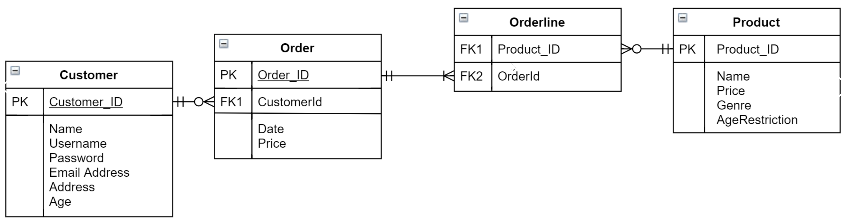
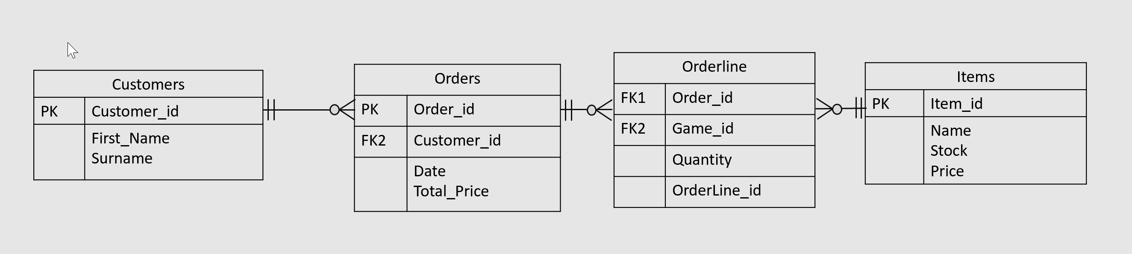

ERD
Agile

Slide 6
Git & GitHub
Git was used for version control,
GitHub was used to host and manage git repositories.
Readme
Network graph
https://github.com/KMRRingQA/IMSProject

Slide 7
Program function macro
ImsSystem takes user input for domain, action
Domains are the defined objects which are passed around between the classes
Passes instructions on which method to carry out to domain.controller
Order gets method-dependant user inputs sends inputs to service, retrieving a result, which may be printed (e.g. a list)
The service does this by pushing the controller inputs to the appropriate DAO method, and retrieving the returned result.
DAO sends updates/queries to MySQL
Services, Controllers, DAOs, Actions, Domains, IMS are all tested using Junit/Mockito
OrderLine has a separate interface as it is not compatible with the CRUD interface

Slide 8
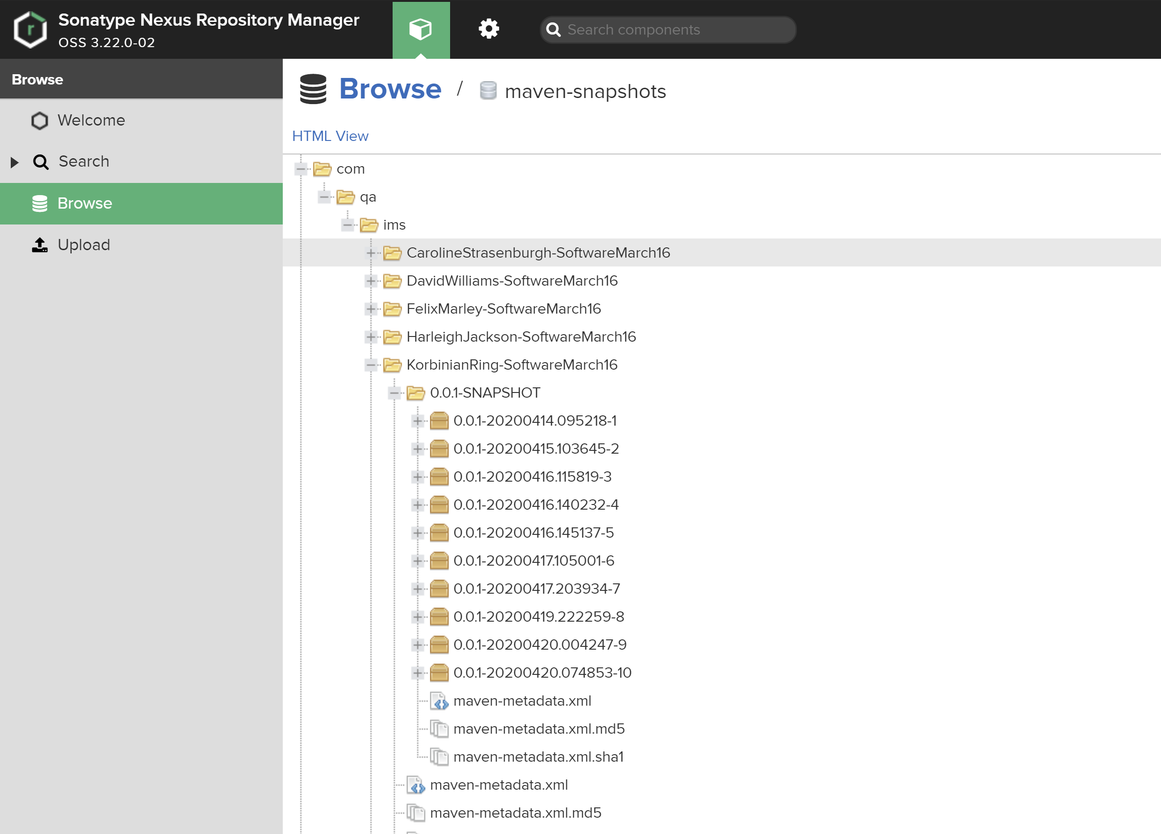
CI Pipeline
Maven to Build
SonarQube for static analysis
Nexus for artifact repository
Jenkins to orchestrate all of the above
http://localhost:8080/

Slide 9

SonarQube
Incredibly useful static analysis tool
  Fixed 6 bugs
  Fixed 4 vulnerabilities
  Fixed 13 security hotspots (SQL injection)
  Reviewed 6 security hotspots
  Fixed 110 smells (63 minor, rest above)
http://34.70.113.116:9000/dashboard?id=com.qa.ims%3AKorbinianRing-SoftwareMarch16

Slide 10
Security
User prepared statements
Be careful with hardcoding log in details
Don’t use basic passwords

Slide 11
Programming function extended
OrderLineServices
Testing DAOS: OrderDAOMysql tests
CRUDServices
OrderController: verifying user input
OrderLineDAO: using mySQL joins & Stringbuilder, including orderlineid
This doesn’t have to be included in the domain itself, only in sql!
IMS: Domains & Actions, testing with Mockito requiring local getInput.

